Slide 1




Getting all children to
read well, quickly.

Slide 2




What are we going to cover?
What is Phonics?
What is Essential Letters and Sounds?
How we teach phonics
Getting children ready to read
Pronouncing pure sounds
Supporting your child with reading at home
The reorganisation of our reading books.
Oxford Owl E-Readers.
Using the letter formations and spelling sequence to support writing at home
© Oxford University Press 2021
Notes:
Overview of Essential Letter and Sounds and how it works
Resources – what they are and how they are used
Assessment and Intervention – what does this look like and how is it implemented
Next Steps – what happens next!
We will check the questions in the chat box at the end of the session so there will be plenty of time to answer and queries then

Slide 3
What is Phonics?
Phonics is a proven method of teaching beginners to read and pronounce words by learning to associate letters or letter groups with the sounds they represent.
There are 44 main sounds in the English Language. Each sound is represented by a grapheme (the written representation of a sound).
© Oxford University Press 2021
Notes:
Begin by explaining what Phonics is. Explain that learning to read the English language is complex and that this information session will give parents & carers the understanding of what Phonics is, the terminolgy used in Phonics and how ELS gives children the skills and knowledge to read well, quickly.

Slide 4
You may have heard your children using this vocabulary!
Phoneme: the smallest single identifiable sound in a word.
For example, in the word 'cat' there are three phonemes c/a/t.
Grapheme: the written representation of a sound.
Digraph: two letters making one sound. For example, /sh/ in the word 'shop'.
Trigraph: three letters making one sound. For example, /igh/ in the word 'night'.
Split digraph: two vowel letters split but are split by one or more consonants. For example, /a-e/ in the word 'cake'.
© Oxford University Press 2021
Notes:
Use flashcards to put this into context. Show parents examples of graphemes, digraphs, trigraphs and split digraphs. Where possible, make the link between same sound, different spelling.
Example:
<a>
acorn
<ai>
rain
<ay>
play
<a-e>
name
<eigh>
eight
<ey>
they
<ea>
great
<aigh>
straight

Slide 5
What is ELS?
Essential Letters and Sounds (ELS) is our chosen phonics programme.
Children will experience the joy of books and language whilst rapidly acquiring the skills they need to become fluent independent readers and writers.
We are already very pleased with the impact that this new scheme is having on your children’s progress with their reading and spelling.
© Oxford University Press 2021
Notes:
We use phonemes and graphemes to teach children the code of our language.
English is one of the most challenging languages to learn as there are so many ways to spell the sounds of our language.
We teach children to decode words – by identifying each of the written sounds within the word before blending them together to read the word. This is a challenging process for children to learn and takes time to master. When they are able to decode and blend to....

Slide 6
How do we teach phonics?
We use a simple, consistent approach to teaching phonics.
We teach phonics every single day from the first full week in Reception.
The lessons follow a very similar format each day with flashcards, practising HRSW words, learning a new sound and mnemonic, reading words and sentences and then independent tasks in their own Activity books.
© Oxford University Press 2021
Notes:
Phonics teaches the link between the spoken sounds of our language and the written version of that sound – the code of our language.
As systematic synthetic phonics programme breaks this down into tiny steps for children to piece together which allows them to decode to read and then spell using the sound to spelling correspondences they have learnt.
We use a simple, consistent approach to teaching phonics.
Your child will experience the same classroom routines within each lesson which reduces cognitive load and maximises the chances of success.
All children are supported within the lesson to use their new phonic knowledge independently.
In every single ELS lesson, your child will make the direct application to reading.

Slide 7
How do we teach phonics?
Lots of opportunities for oral blending- /c/ /oa/ /t/
We teach the ‘code’ for reading, alongside teaching vocabulary.
You may have seen staff in EYFS with Phonics flashcards fastened to their lanyards throughout the day to review new sounds and the graphemes taught.
Some examples of the slides that your children see are on the following slides.
© Oxford University Press 2021

Slide 8
How do we teach phonics?
But before we do, we’ll model our blending with robot arms to you.
For the older children still needing support with their phonics, we use a tapping technique on the table for each phoneme instead.
© Oxford University Press 2021

Slide 9

How do we teach phonics?
© Oxford University Press 2021
Notes:
In ELS we do not ask children questions before we have taught them.
For example, when teaching a new sound, rather than asking children if they know any words with the sound in - we give the children 3 words that contain that sound. You can try this with your children at home.

Slide 10


How do we teach phonics?
© Oxford University Press 2021
Notes:
The new teaching is always highlighted so that it is easy for all children to see where the new GPC they have been taught is located. First we say the new sound, then we find it in the word. Finally, we decode and blend. Children have as much or as little support as needed. We want every child to feel confident and successful at each step.

Slide 11

How do we teach phonics?
© Oxford University Press 2021
Notes:
In the beginning of Reception, we learn to read words and then captions, phrases and sentences. As children learn more of the code of our language we are able to build more complex sentences for them to read.
Here we have a sentence from Year One. We build the code for the children and as this knowledge grows we are able to read more complex sentences.

Slide 12

ELS Progression
© Oxford University Press 2021
Notes:
In Reception your children will learn all the single letter sounds and begin to learn diagraphs and trigraphs.

Slide 13

ELS Progression
© Oxford University Press 2021

Slide 14
Pronouncing pure sounds
This is the most important part of today’s meeting:
We must use pure sounds when we are pronouncing the sounds and supporting children in reading words.
c a t not cuh a tuh
If we mispronounce these sounds we will make reading harder for our children.
We are going to create and upload videos for this on our school website where you can hear the correct pronunciation of the sounds.
© Oxford University Press 2021
Notes:
We must not be adding a schwa sound to the end of letters when they are pronounced.
Just think about this: Instead of /c/ /a/ /t/ if we say /cuh/ /a/ /tuh/ - cuhatuh – this does not blend into a word! Not using the pure sounds makes blending harder so we must never use a schwa after the initial sound.

Slide 15
Supporting your child with reading at home
Only 1 in 3 children are read a bedtime story night.
Reading a bedtime story every night to your child improves their outcomes.
If your child views themselves as a ‘good reader’ when they leave Primary School, they are more likely to earn a higher salary in their 40s.
© Oxford University Press 2021
Notes:
Reading until they are 3 improves outcomes in YR, reading until they are 5 improves outcomes in Y6 and reading until they are 8 improves outcomes aged 16!
Children who achieved the Early Learning goals for literacy are 11 times more likely to achieve the expected outcomes in Maths at the end of KS2. Reading underpins everything.
We want all our children to leave primary school able to read well and confidently – you can support us in this journey.

Slide 16
Reading Books in EYFS
The children are given a book each week.
Your child should be able to read their book confidently.
We want them to practise reading their book THREE times across the week working on these skills:
decoding
fluency
and expression.
They also have e-readers which we will talk about more later.
The reorganisation of the books will be explored next.
© Oxford University Press 2021
Notes:
We want children to only have success when learning to read
Decode – explain this meaning
Fluency – recognising the sound for spelling within the word and blending fluently
expression – model this for the children in school, when reading at home we want children to start to think about expression and intonation. For example, if someone is asking a question let’s get the children to make their voices sound like they are asking a question.

Slide 17
Reorganisation of our KS1 Reading Books
All of our KS1 reading books have been reorganised and relabelled to ensure that the books that children are reading from are entirely decodable for the sounds they have already learnt in school.
They are no longer colour banded, but are now numerically graded according to the sounds and the HRSW (Harder to Read and Spell Words) that they contain.
Your child should be able to decode their book confidently. They should then be able to work on their fluency and expression when rereading sentences or paragraphs as required.
They also need to be asked questions to check on their understanding.
© Oxford University Press 2021
Notes:
We want children to only have success when learning to read
Decode – explain this meaning
Fluency – recognising the sound for spelling within the word and blending fluently
expression – model this for the children in school, when reading at home we want children to start to think about expression and intonation. For example, if someone is asking a question let’s get the children to make their voices sound like they are asking a question.

Slide 18
Reorganisation of our KS1 Reading Books
I will show you some examples of the Reading books and their labels.
There are 18 sets of sounds taught starting from Set 1:
s, a, t and p.
and ending with Set 18:
/z/ se, ze, /ear/ eer, ere
/sh/ ti, ss, ci /ar/ al (half)
/or/ augh /zh/ si
-ous, -ion, -ian
After this, the books in Sets 19 and 20 have rare GPCs (Grapheme Phoneme Correspondences) such as:
/a/ au and /f/ gh as in the word ‘laugh’.
Your child can embrace their CURIOSITY by finding the words with the new GPCs within their book.
After this, they will be challenged with ‘Chapter books’.
There is a list of these for you to take home.
© Oxford University Press 2021
Notes:
We want children to only have success when learning to read
Decode – explain this meaning
Fluency – recognising the sound for spelling within the word and blending fluently
expression – model this for the children in school, when reading at home we want children to start to think about expression and intonation. For example, if someone is asking a question let’s get the children to make their voices sound like they are asking a question.

Slide 19
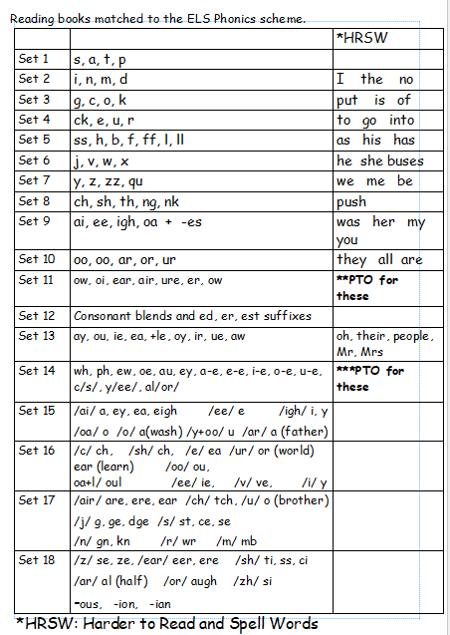
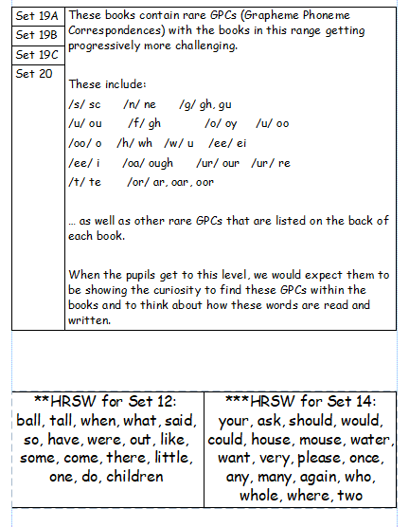

Slide 20
Oxford Owl E-books
These have been very well-received by the children who have accessed them.
However, uptake is still rather disappointing.
The children – and particularly the boys – who have accessed them have so much to say about how much they enjoy the books.
These books are perfectly matched to the whole group of sounds that your child has been taught in class.
In KS1, we are celebrating the children who have read their E-books each week and they are being awarded a house-point linked to Curiosity. It’s also a bit of a competition between the three classes!
© Oxford University Press 2021
Notes:
We want children to only have success when learning to read
Decode – explain this meaning
Fluency – recognising the sound for spelling within the word and blending fluently
expression – model this for the children in school, when reading at home we want children to start to think about expression and intonation. For example, if someone is asking a question let’s get the children to make their voices sound like they are asking a question.

Slide 21

Supporting your child with writing at home
You can use the spelling sequence with your children at home to support them with their writing.
Let’s try this with the word: rain
We also practise saying our sentences before we write them to make sure we write the sentence we have planned and to ensure it makes sense!
© Oxford University Press 2021
Notes:
Use the spelling sequence to model rain
Say the word – warm it up – stretch the word – robot talk the word – blend the word – count the sounds within the word – say the word
You can talk about how you support your children with their writing in school.

Slide 22
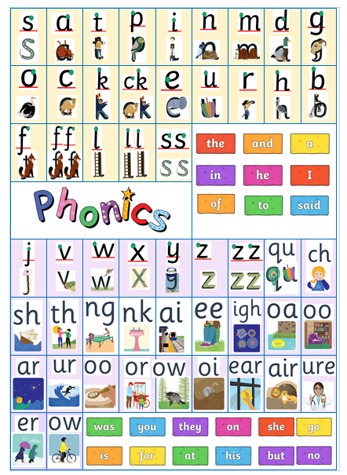

Slide 23
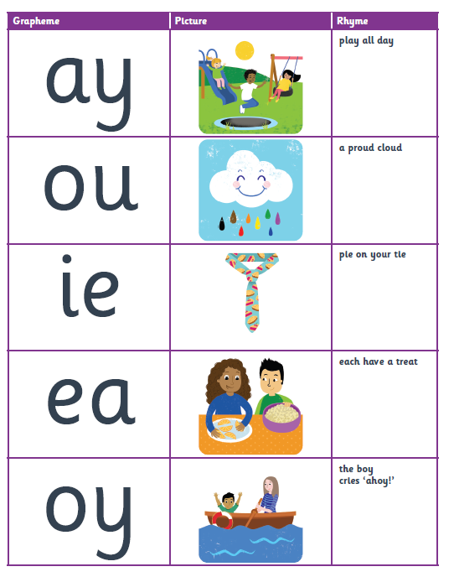
When we move onto Phase 5, the children are learning alternative graphemes/spellings for the same sounds.
The children have already learnt ai at Phase 3 but now they learn that ay also makes the ai sound.
Things even get a lot more tricky:
ear in clear
ear /ur/ in search
ear /air/ in bear
ere /ear/ in here
ere /air/ in where
air on hair
are /air/ in share
And then of course air is a word!

Slide 24

Questions
© Oxford University Press 2021

